Slide 1

SPOTIFY ANALYSIS
Mythili k s
Dads - Oct batch

Slide 2
SUMMARY
Dataset Preparation
Dashboard Design
Storytelling
Insights & Recommendation

Slide 3
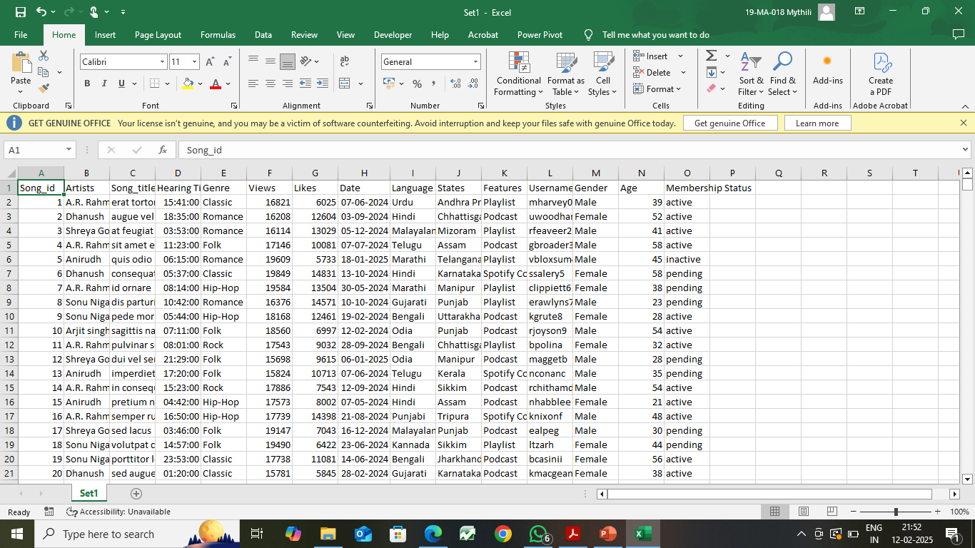
DATA PREPARATION
Generated data from Mockaroo
Dataset - Spotify Analysis
Total rows – 2000
Total Columns – 15
Cleaned the Dataset

Slide 4
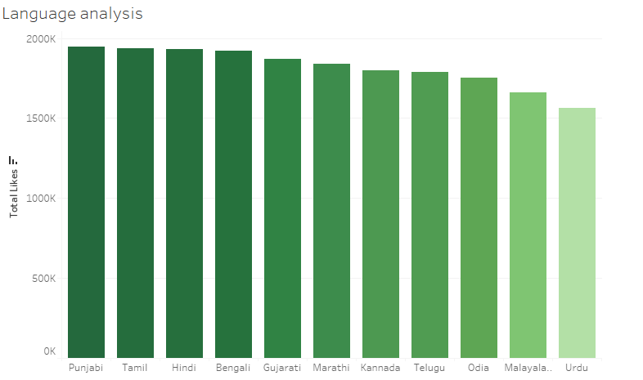
CHARTS CREATION
Imported the data into Tableau
Designed Charts & KPI’s
Created some Calculated fields
Popularity
Year
Month
Premium Customers

Slide 5
DASHBOARD CREATION
Created Dashboard
Aligned Charts in Dashboard
Setuped KPI’s
Added Slicers
Designed Dashboard

Slide 6
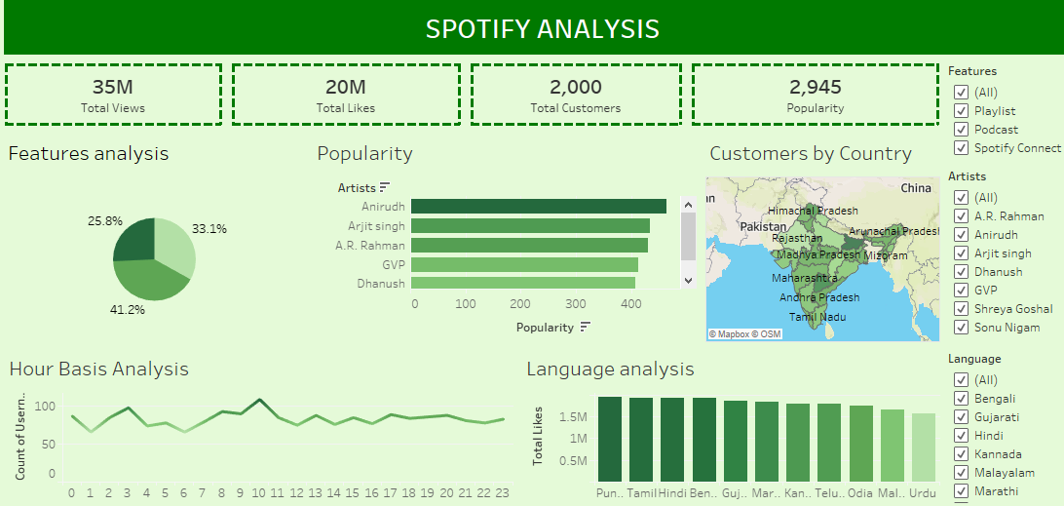
DASHBOARD

Slide 7
STORY TELLING
Created Stories
Added Captions to the Stories
Aligned the stories

Slide 8
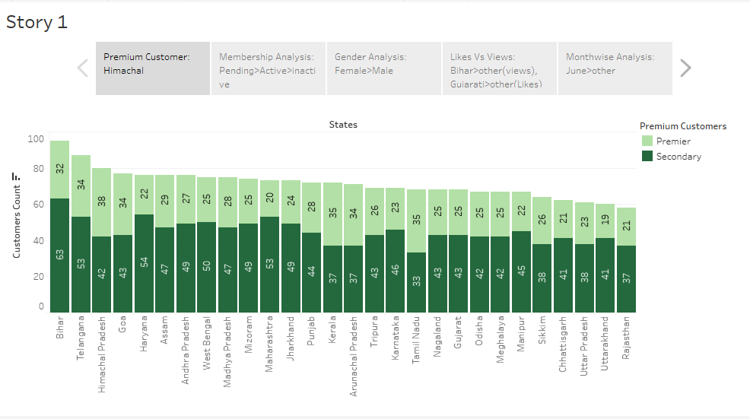
STORY TELLING

Slide 9
INSIGHTS
Particulars | High Rate | Low Rate
Spotify Customers | Bihar | Rajasthan
Premium Customers | Himachal | Uttarakhand
Membership Status | Pending | Inactive
Top Customers | Female | Male
Month wise | June | Feb
Age Group | 25-30 | 35-45

Slide 10
RECOMMENDATIONS
Membership Status
Age Group
Features

Slide 11
THANK YOU

